Slide 1
Sem 13
Memento
Observer

Slide 2
MEMENTO
DP Behavioral

Slide 3
Memento
Saving the state of an object
Object can restore the state based on a previous state stored in the manager of states

Slide 4
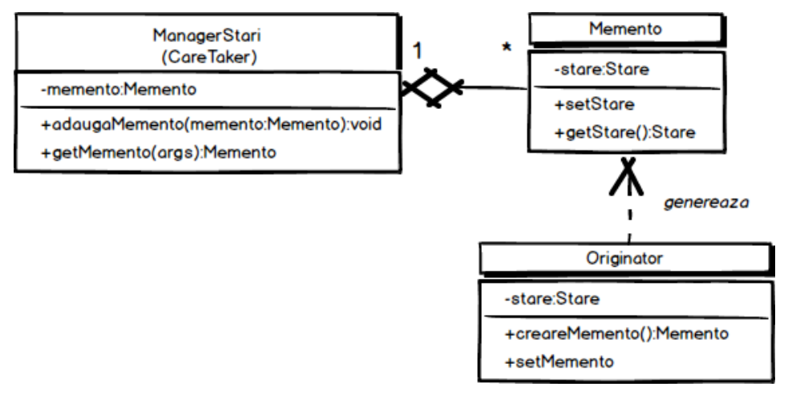
Memento - Diagram

Slide 5
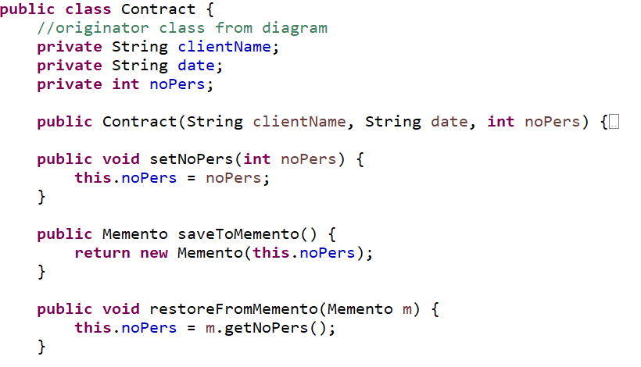
Memento – Example

Slide 6
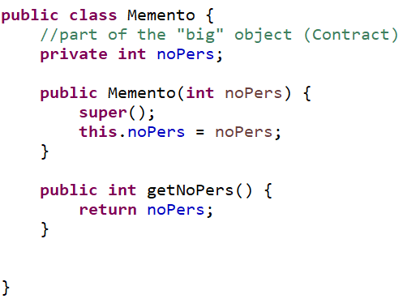
Memento – Example

Slide 7
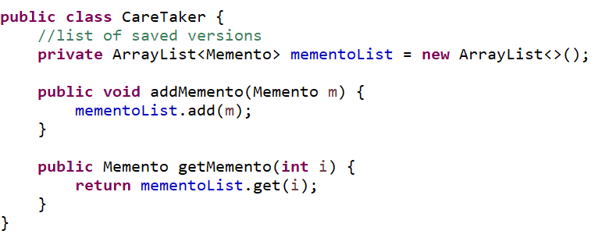
Memento – Example

Slide 8
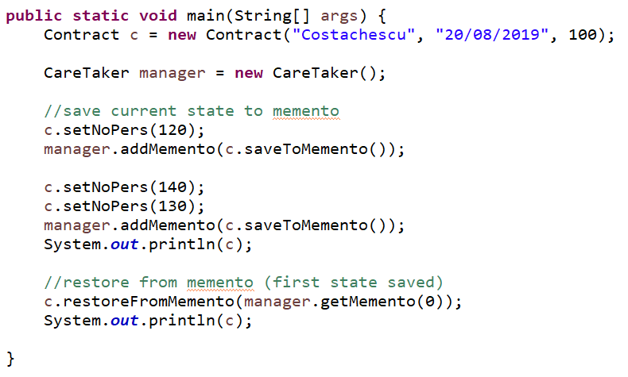
Memento – Example

Slide 9
OBSERVER
DP Behavioral

Slide 10
Observer
Notify the components if one event happened
The components subscribe to the event
When one event is happening more components can be notified once

Slide 11
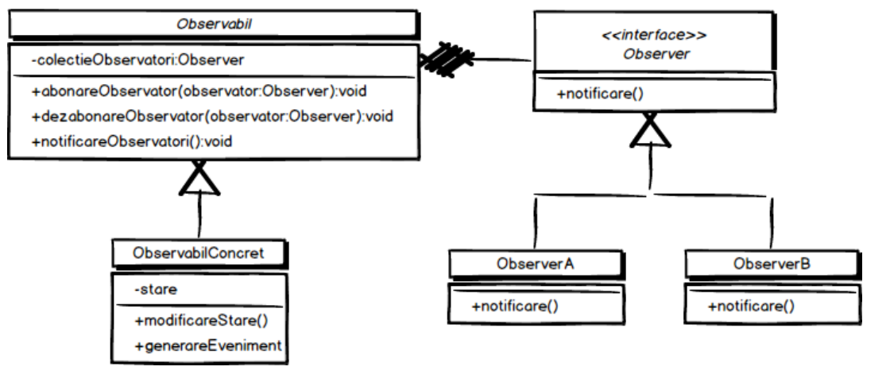
Observer - Diagram

Slide 12

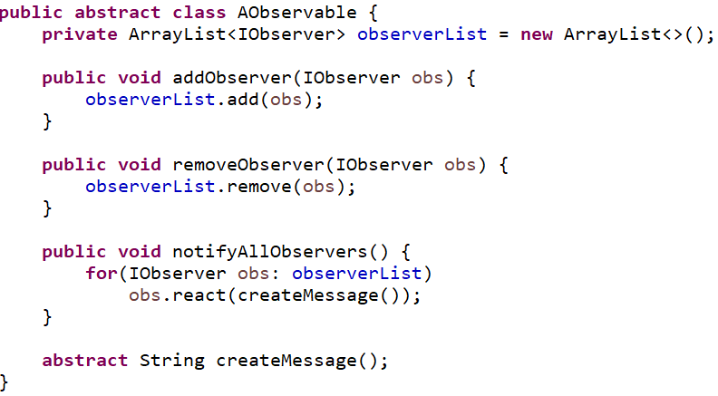
Observer – Example

Slide 13
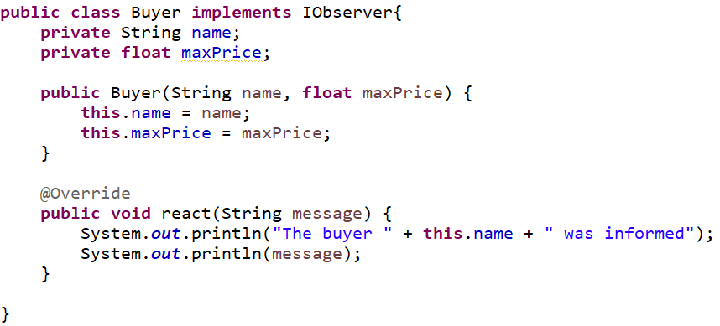
Observer – Example

Slide 14
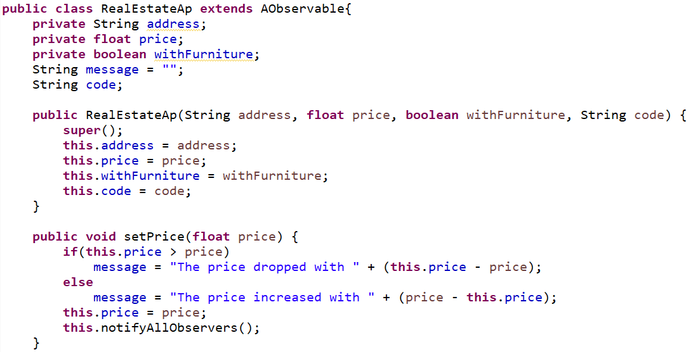
Observer – Example

Slide 15
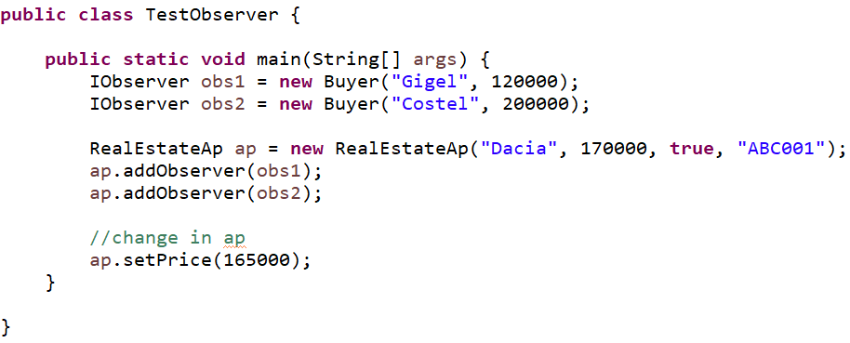
Observer – Example

